Slide 1
CSE495B (Natural Language Processing) Lecture 4
Neural Networks Basics

Slide 2
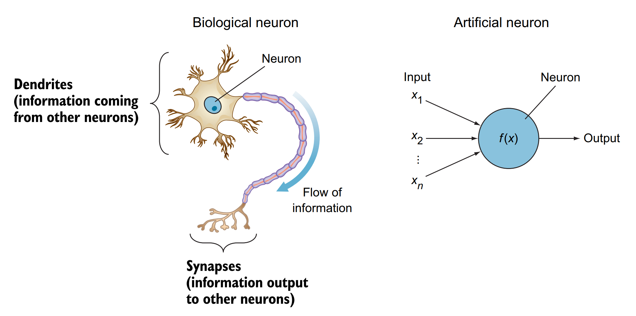
Perceptron
The simplest neural network is a perceptron, which consists of a single neuron
Conceptually, the perceptron functions is like a biological neuron

Slide 3
Perceptron
The artificial neuron performs two consecutive functions
It calculates the weighted sum of the inputs to represent the total strength of the input signals
Then it applies a step function to the result
To determine whether to fire the output 1 if the signal exceeds a certain threshold or
0 if the signal doesn’t exceed the threshold
Not all input features are equally useful or important.
To represent that, each input node is assigned a weight value, called its connection weight, to reflect its importance

Slide 4
Main components of a Neural Network
Input layer— Contains the feature vector
Hidden layers—The neurons are stacked on top of each other in hidden layers
They are called “hidden” layers because we don’t see or control the input going into these layers or the output
All we do is feed the feature vector to the input layer and see the output coming out of the output layer
Weight connections (edges)—Weights are assigned to each connection between the nodes to reflect the importance of their influence on the final output prediction
In graph network terms, these are called edges connecting the nodes
Output layer — We get the answer or prediction from our model from the output layer
Depending on the setup of the neural network, the final output
Could be a real-valued output (regression problem) or
A set of probabilities (classification problem)

Slide 5
Activation functions
Activation functions are sometimes referred to as transfer functions or nonlinearities because they transform the linear combination of a weighted sum into a nonlinear model
The purpose of the activation function is to introduce nonlinearity into the network
Without it, a multilayer perceptron will perform similarly to a single perceptron no matter how many layers we add
Activation functions are needed to restrict the output value to a certain finite value

Slide 6
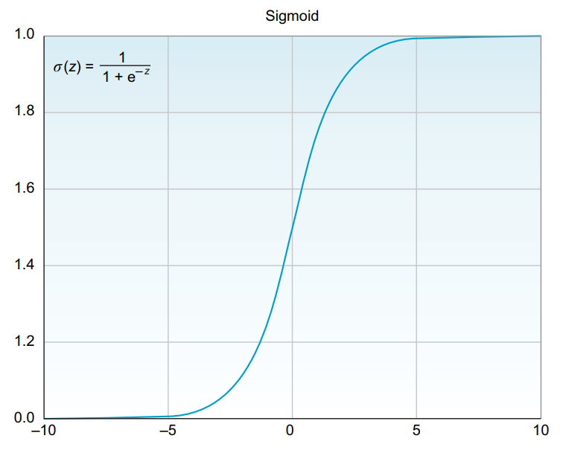
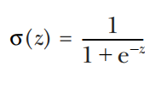
Sigmoid/Logistic Activation Function
This is one of the most common activation functions
It is often used in binary classifiers to predict the probability of a class when we have two classes
Sigmoid or logistic functions convert infinite continuous variables (range between –∞ to +∞) into simple probabilities between 0 and 1
It is also called the S-shape curve because when plotted in a graph, it produces an S-shaped curve.

Slide 7
Hyperbolic Tangent (tanh) Activation Function
The hyperbolic tangent function is a shifted version of the sigmoid version
Instead of squeezing the signal values between 0 and 1, tanh squishes all values to the range –1 to 1
Tanh almost always works better than the sigmoid function in hidden layers because it has the effect of centering the data so that the mean of the data is close to zero rather than 0.5, which makes learning for the next layer a little bit easier
One of the downsides of both sigmoid and tanh functions is that if (z) is very large or very small
Then the gradient (or derivative or slope) of this function becomes very small (close to zero), which will slow down gradient descent

Slide 8
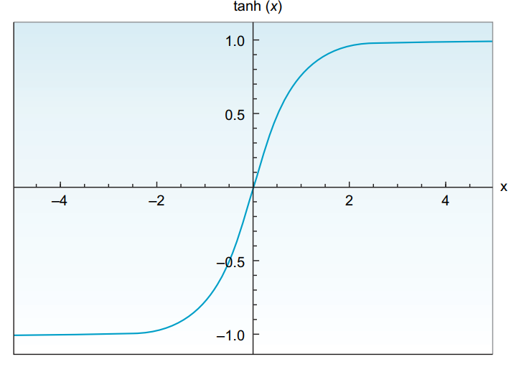

Hyperbolic Tangent (tanh) Activation Function

Slide 9
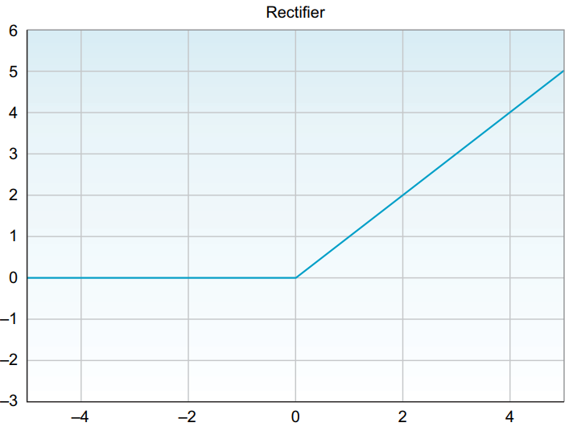
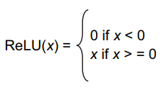
Rectified Linear (ReLU) Activation Function
The rectified linear unit (ReLU) activation function activates a node only if the input is above zero
If the input is below zero, the output is always zero
But when the input is higher than zero, it has a linear relationship with the output variable
ReLU is considered the state-of-the-art activation function because it works well in many different situations, and it tends to train better than sigmoid and tanh in hidden layers

Slide 10
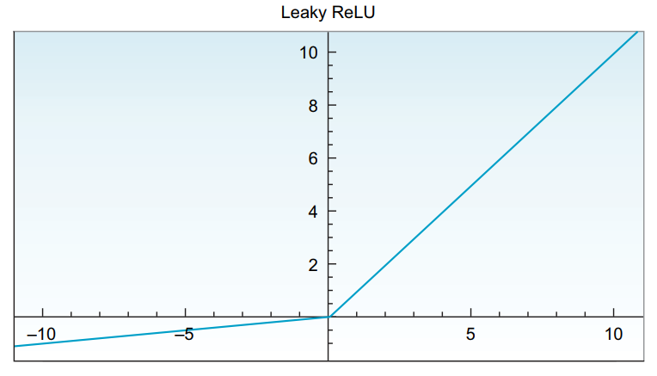
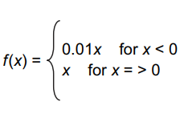
Leaky ReLU Activation Function
One disadvantage of ReLU activation is that the derivative is equal to zero when (x) is negative
Leaky ReLU is a ReLU variation that tries to mitigate this issue
Instead of having the function be zero when x < 0, leaky ReLU introduces a small negative slope (around 0.01) when (x) is negative
It usually works better than the ReLU function

Slide 11
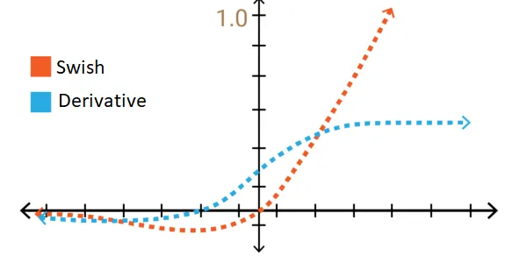
Swish Activation Function
Swish is function derived from sigmoid : f(x) = x · sigmoid(x).
Swish works better than ReLU on deeper models across several challenging data sets
The curve of the Swish function is smooth, and the function is differentiable at all points
This is helpful during the model optimization process and is one of the reasons that swish outperforms ReLU
Swish function is “not monotonic”
This means that the value of the function may decrease even when the input values are increasing
Function is unbounded above and bounded below

Slide 12
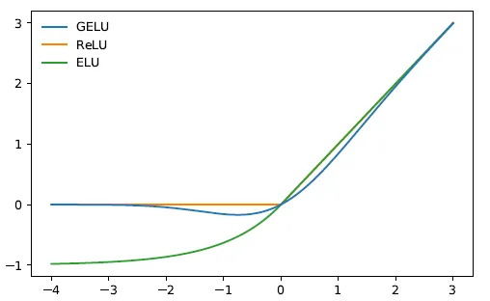

GELU Activation Function
The Gaussian Error Linear Unit or GELU, is derived from standard Gaussian cumulative distribution function
The GELU nonlinearity weights inputs by their percentile, rather than by their sign as in ReLUs
GELU can be thought of as a smoother ReLU
GPT, BERT, and most transformers use GELU
ELU activation layer performs identity operation on positive inputs and an exponential nonlinearity on negative inputs

Slide 13
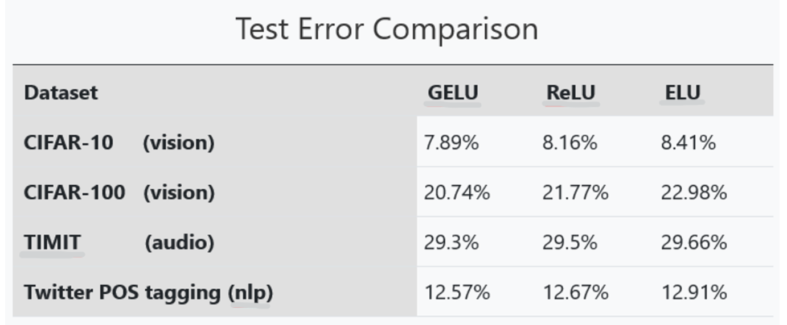
GELU Improvement

Slide 14
Softmax Function
The softmax function is a generalization of the sigmoid function
It is used to obtain classification probabilities when we have more than two classes
It forces the outputs of a neural network to sum to 1 (for example, 0 < output < 1)
A very common use case in deep learning problems is to predict a single class out of many options (more than two)
Softmax is the go-to function that we often use at the output layer of a classifier when we are working on a problem where we need to predict a class between more than two classes
Softmax works fine classifying two classes, as well – it will basically work like a sigmoid function

Slide 15
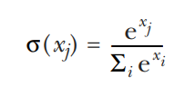
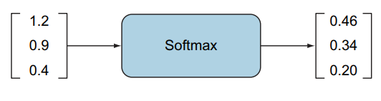
Softmax Activation Function (2)

Slide 16
Cost/Loss/Error Function
The error function is a measure of how “wrong” the neural network prediction is with respect to the expected output (the label)
It quantifies how far we are from the correct solution
For example, if we have a high loss, then our model is not doing a good job
The smaller the loss, the better the job the model is doing
The larger the loss, the more our model needs to be trained to increase its accuracy

Slide 17


Mean Square Error Loss Function
Mean squared error (MSE) is commonly used in regression problems that require the output to be a real value (like house pricing)
Instead of just comparing the prediction output with the label (ŷ_{i} – y_{i}), the error is squared and averaged over the number of data points
MSE is a good choice for a few reasons
The square ensures the error is always positive, and
Larger errors are penalized more than smaller errors
MSE is quite sensitive to outliers, since it squares the error value
A variation error function of MSE called mean absolute error (MAE) is immune to this issue
It averages the absolute error over the entire dataset without taking the square of the error

Slide 18
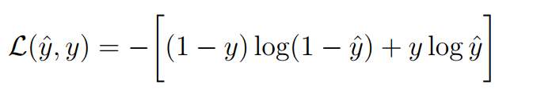
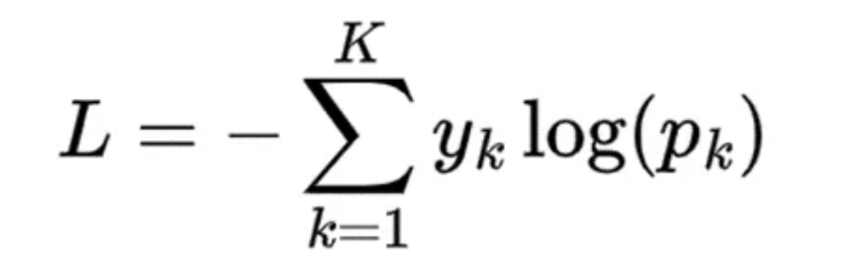
Cross-entropy loss function
The loss function L(ŷ; y) produces a single scalar value
Most common for Neural Networks
Cross-entropy is commonly used in classification problems because it quantifies the difference between two probability distributions
How close is the predicted distribution to the true distribution?
That is what the cross entropy loss function determines
The cross entropy is the average number of bits needed to encode data coming from a source with distribution p when we use model q

Slide 19
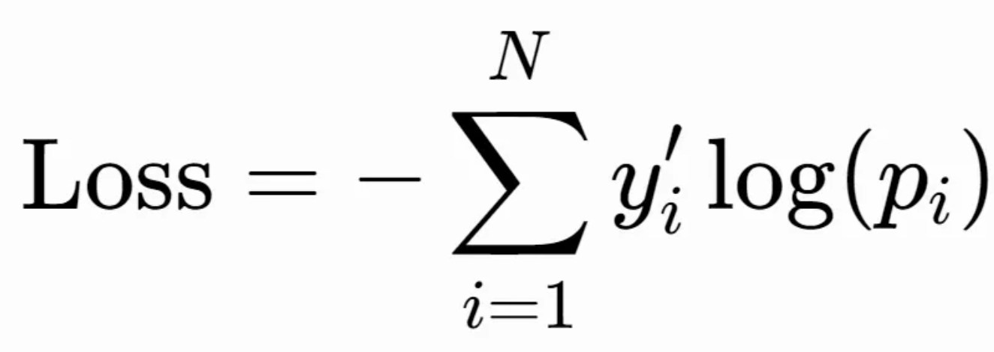
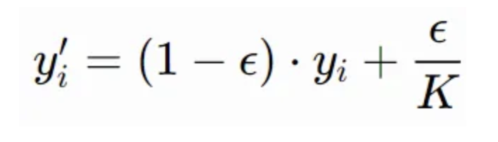
Label-smoothed Cross-entropy loss function
With label smoothing, the hard one-hot encoded vectors representing true labels are replaced by a smoothed version, which assigns a little bit of probability mass to all other classes.
where p_{i} are the predicted probabilities, and N,K are the number of mini-batch/classes.

Slide 20

Autoencoders using Neural Networks
Autoencoders are a specific type of feedforward neural networks where the input is the same as the output
They compress the input into a lower-dimensional code and then reconstruct the output from this representation
The code is a compact “summary” or “compression” of the input, also called the latent-space representation

Slide 21
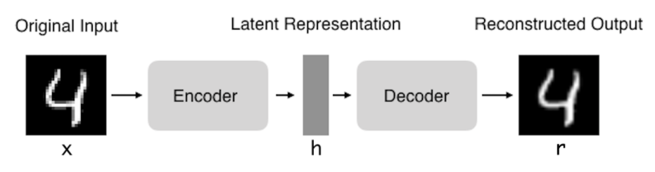
Autoencoders using Neural Networks
Autoencoders (AE) work by compressing the input into a latent-space representation, and then reconstructing the output from this representation
This kind of network is composed of two parts :
Encoder: This is the part of the network that compresses the input into a latent-space representation. It can be represented by an encoding function h=f(x)
Decoder: This part aims to reconstruct the input from the latent space representation. It can be represented by a decoding function r=g(h)

Slide 22
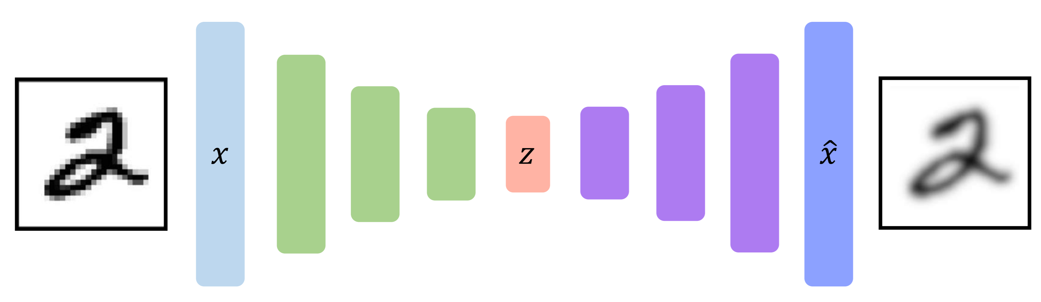

Slide 23
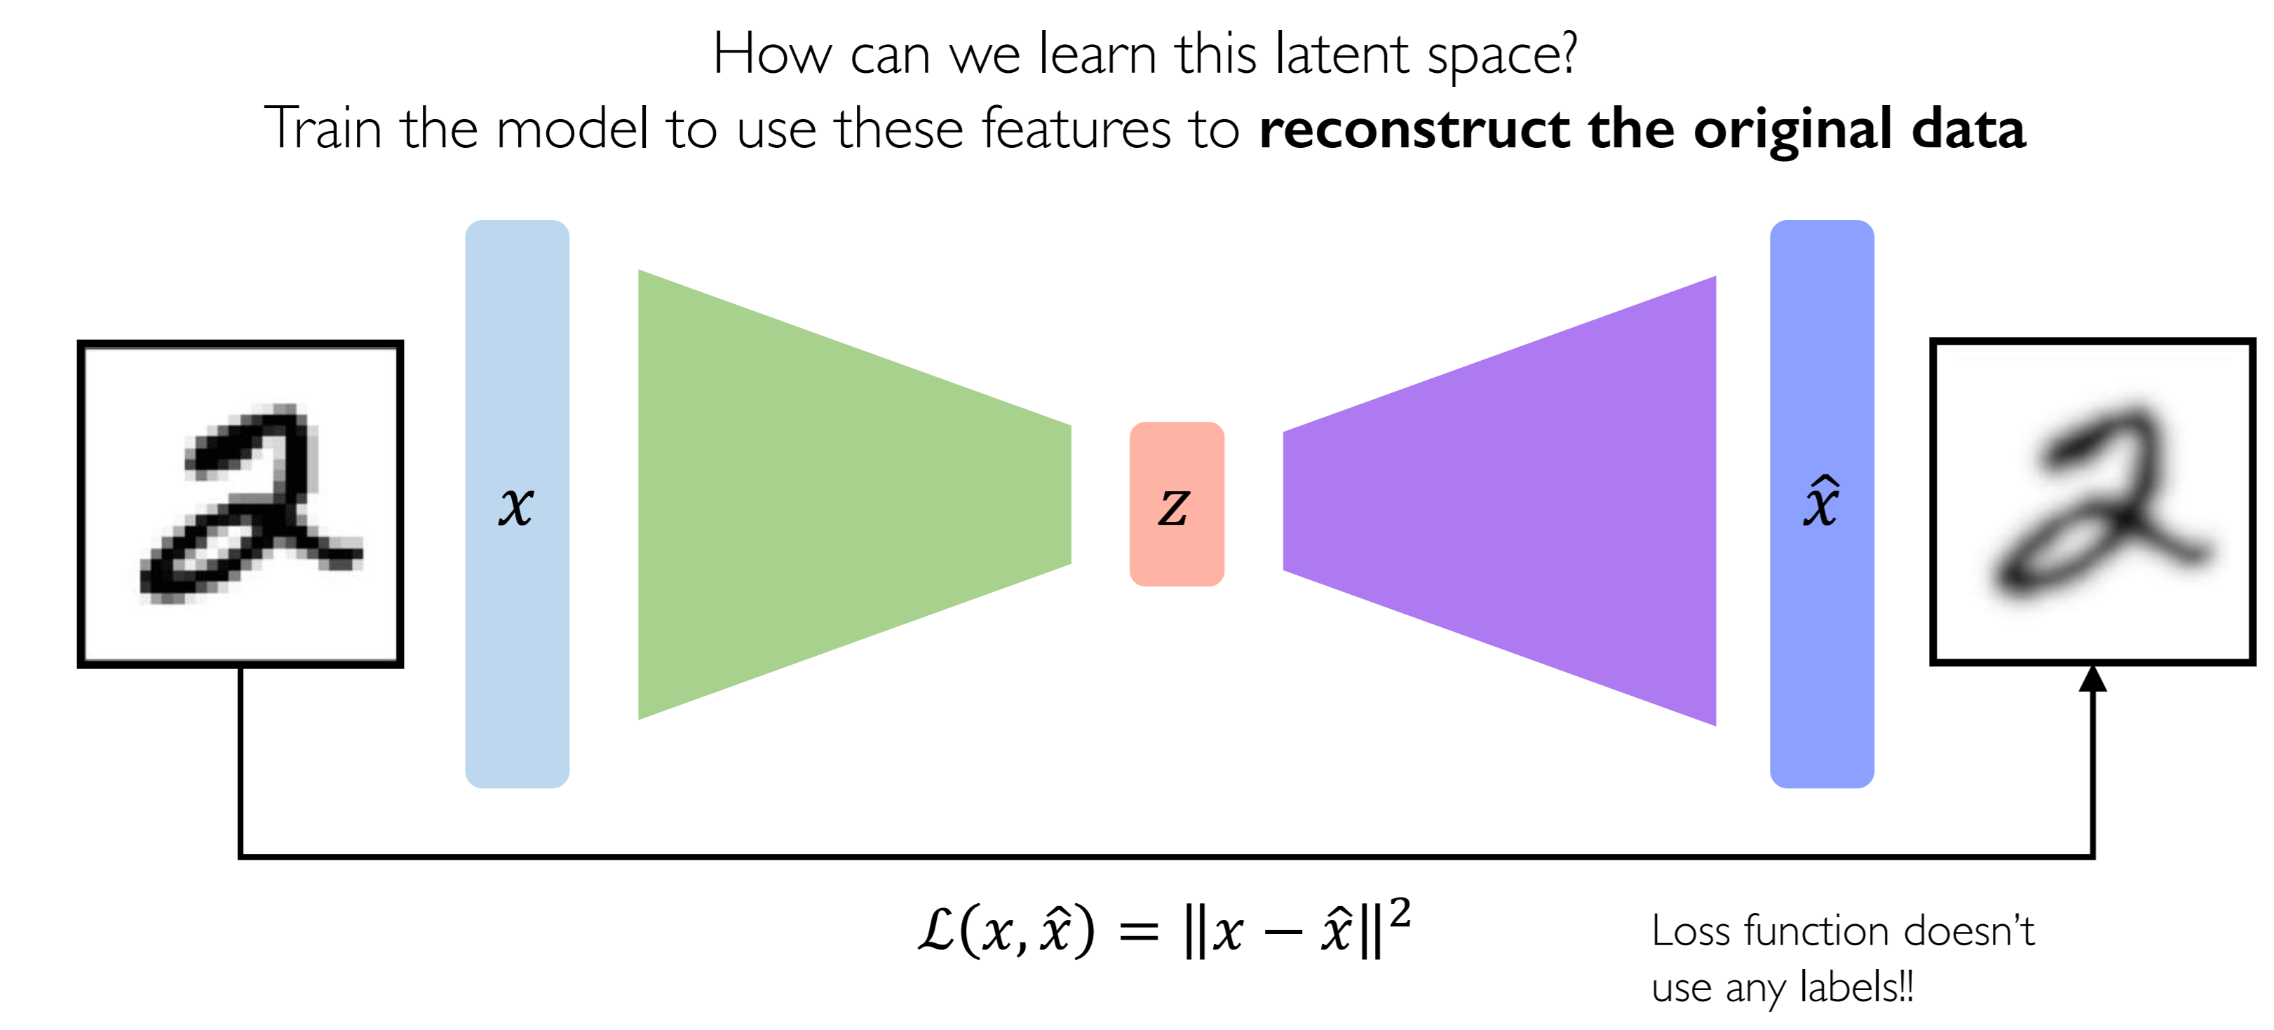
Learn parameters for autoencoding

Slide 24
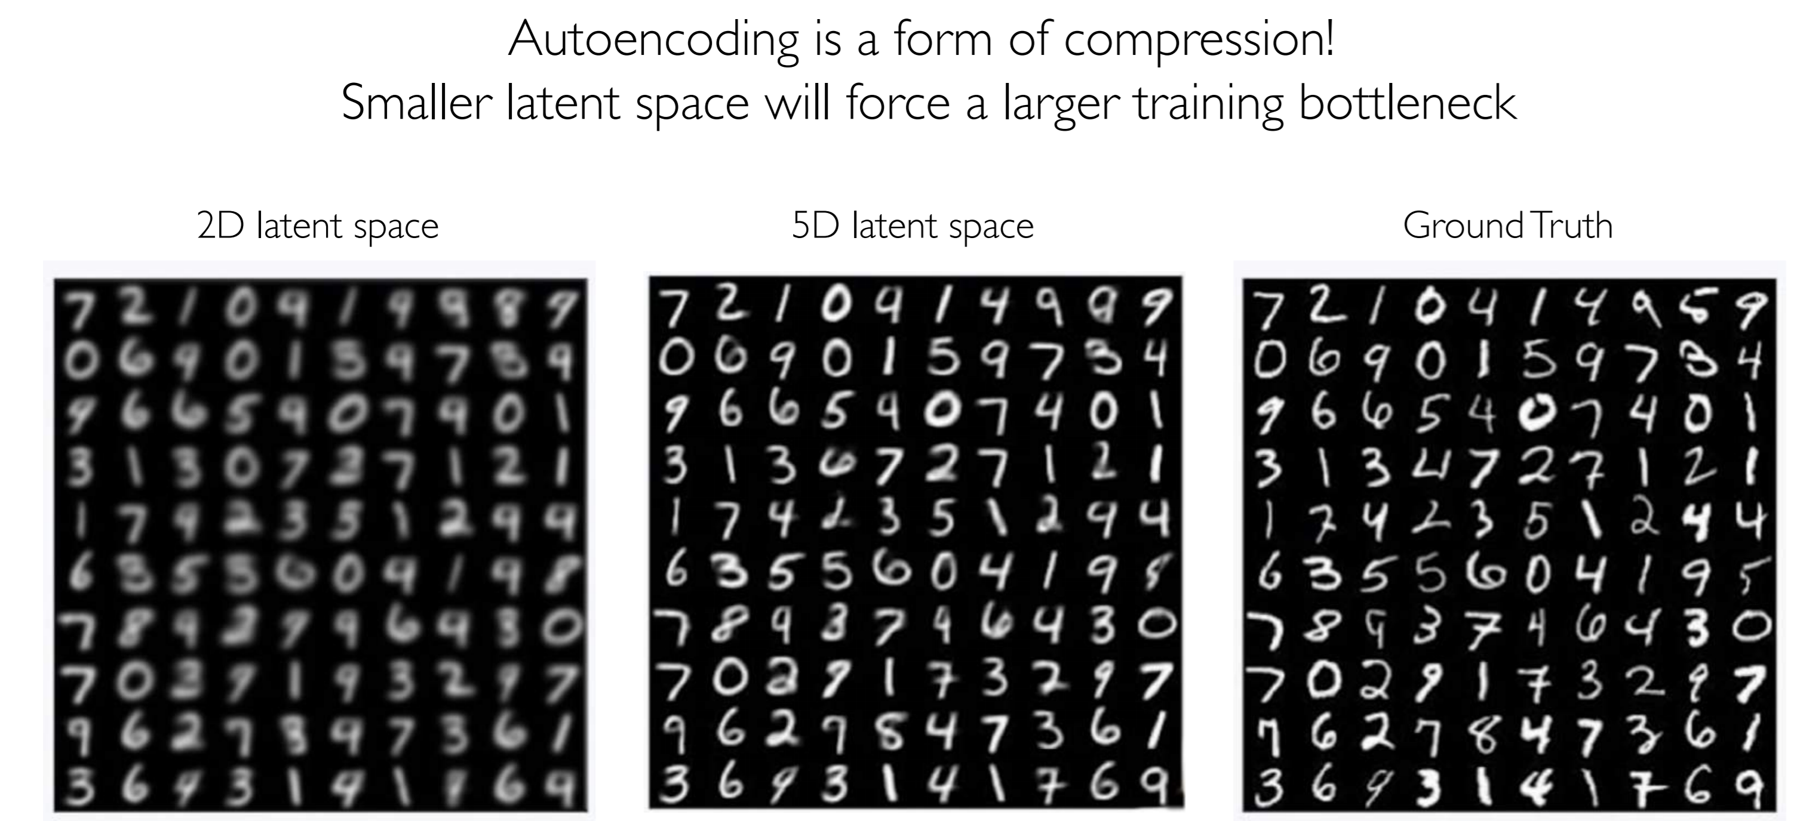
Dimensionality of latent space

Slide 25
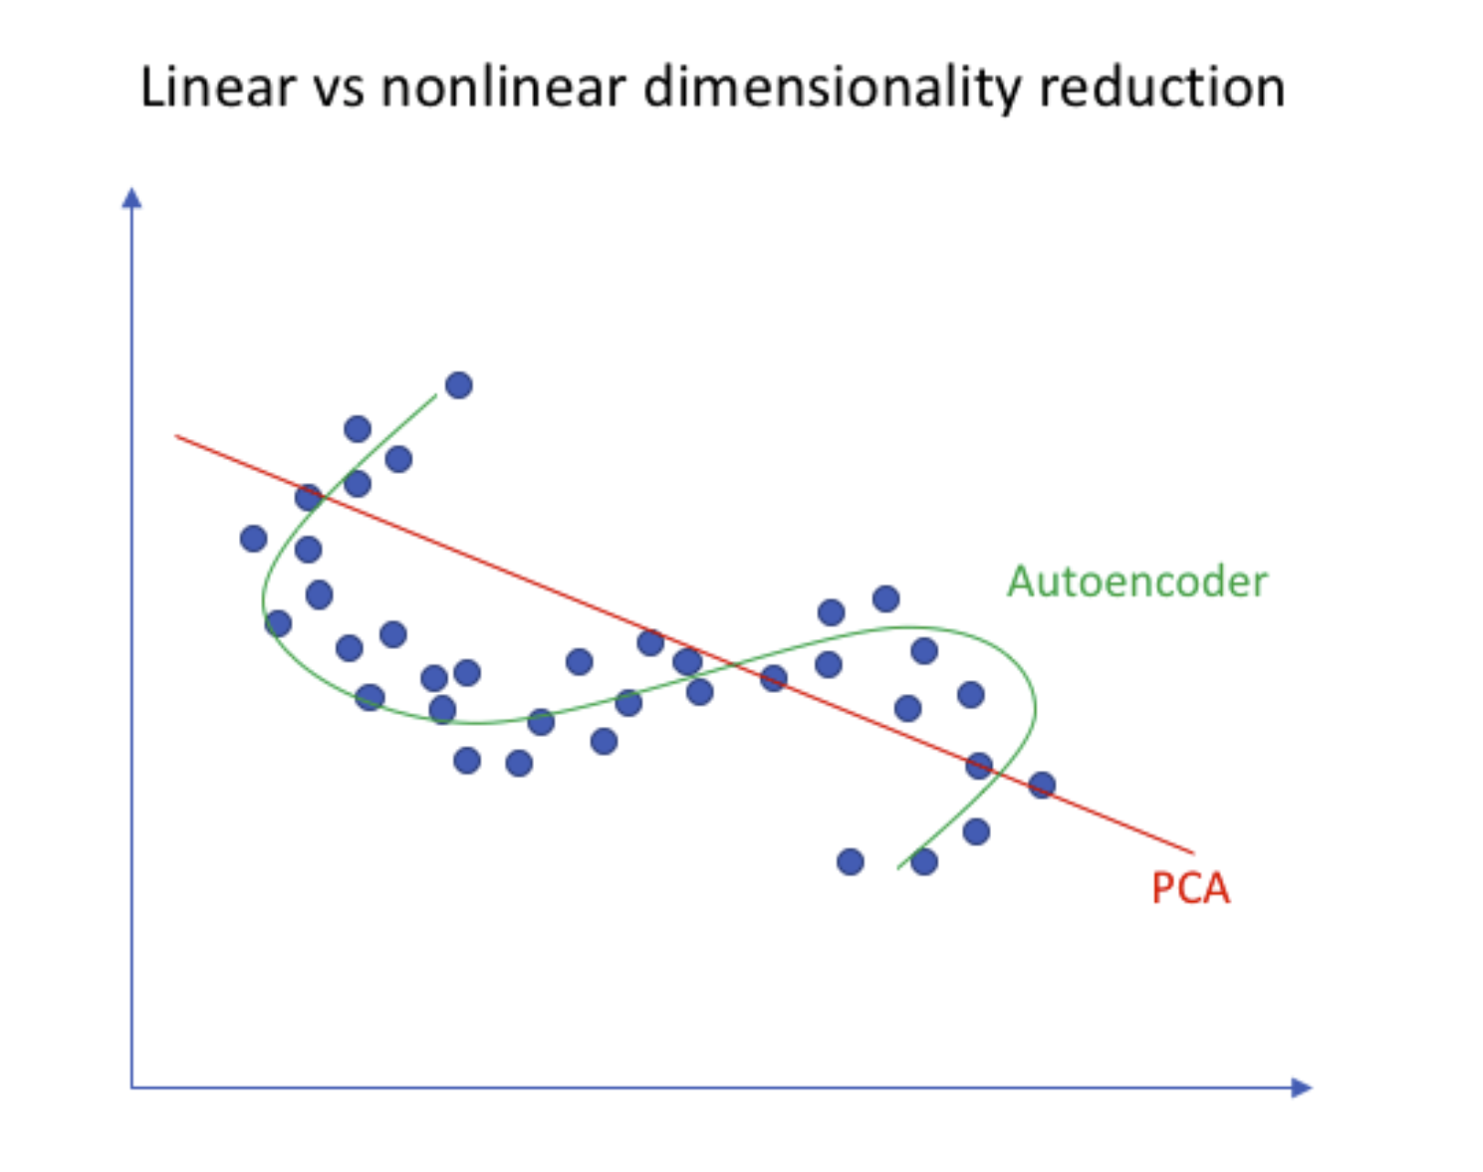
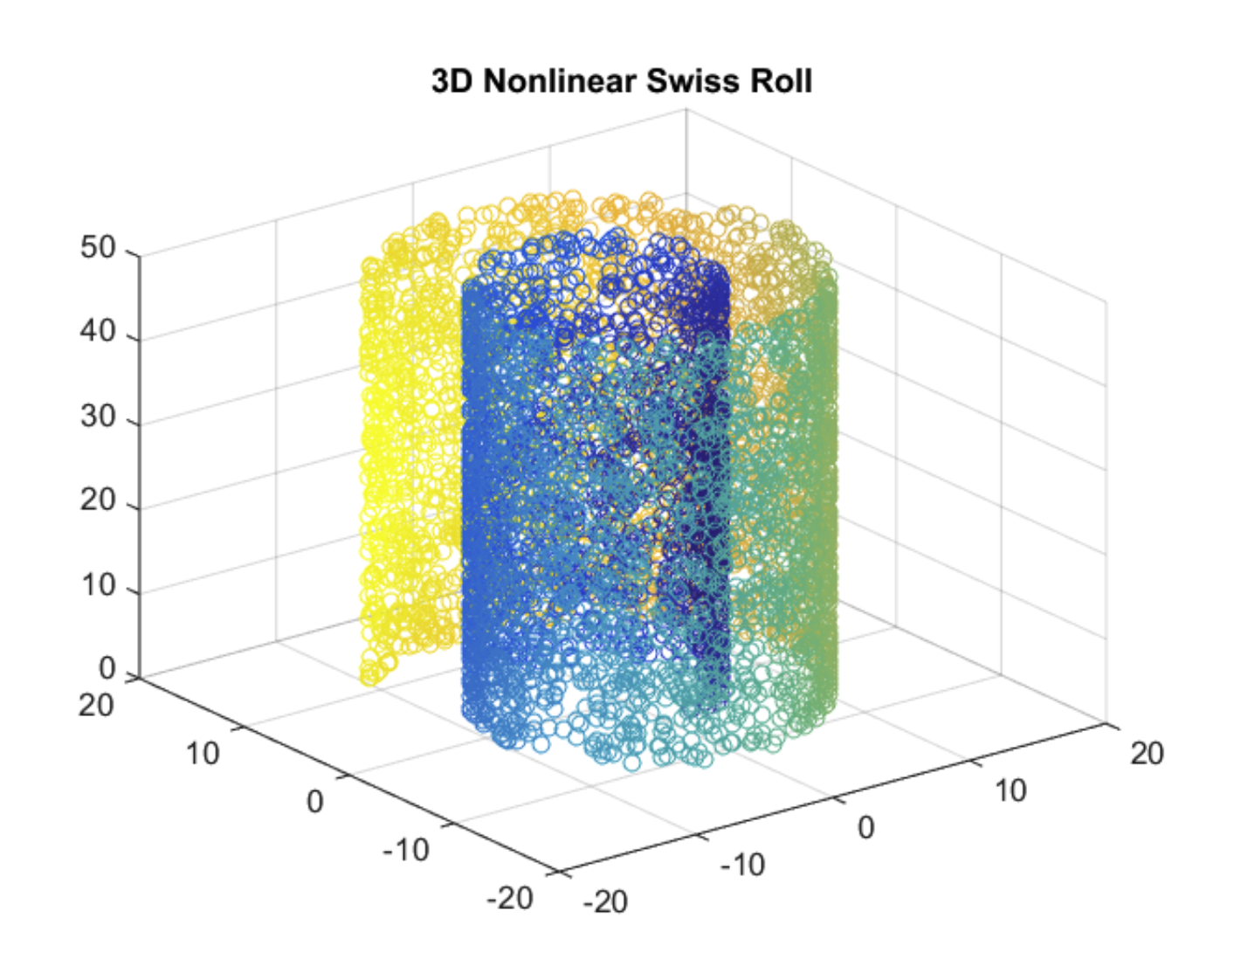
PCA vs NN-autoencoding

Slide 26
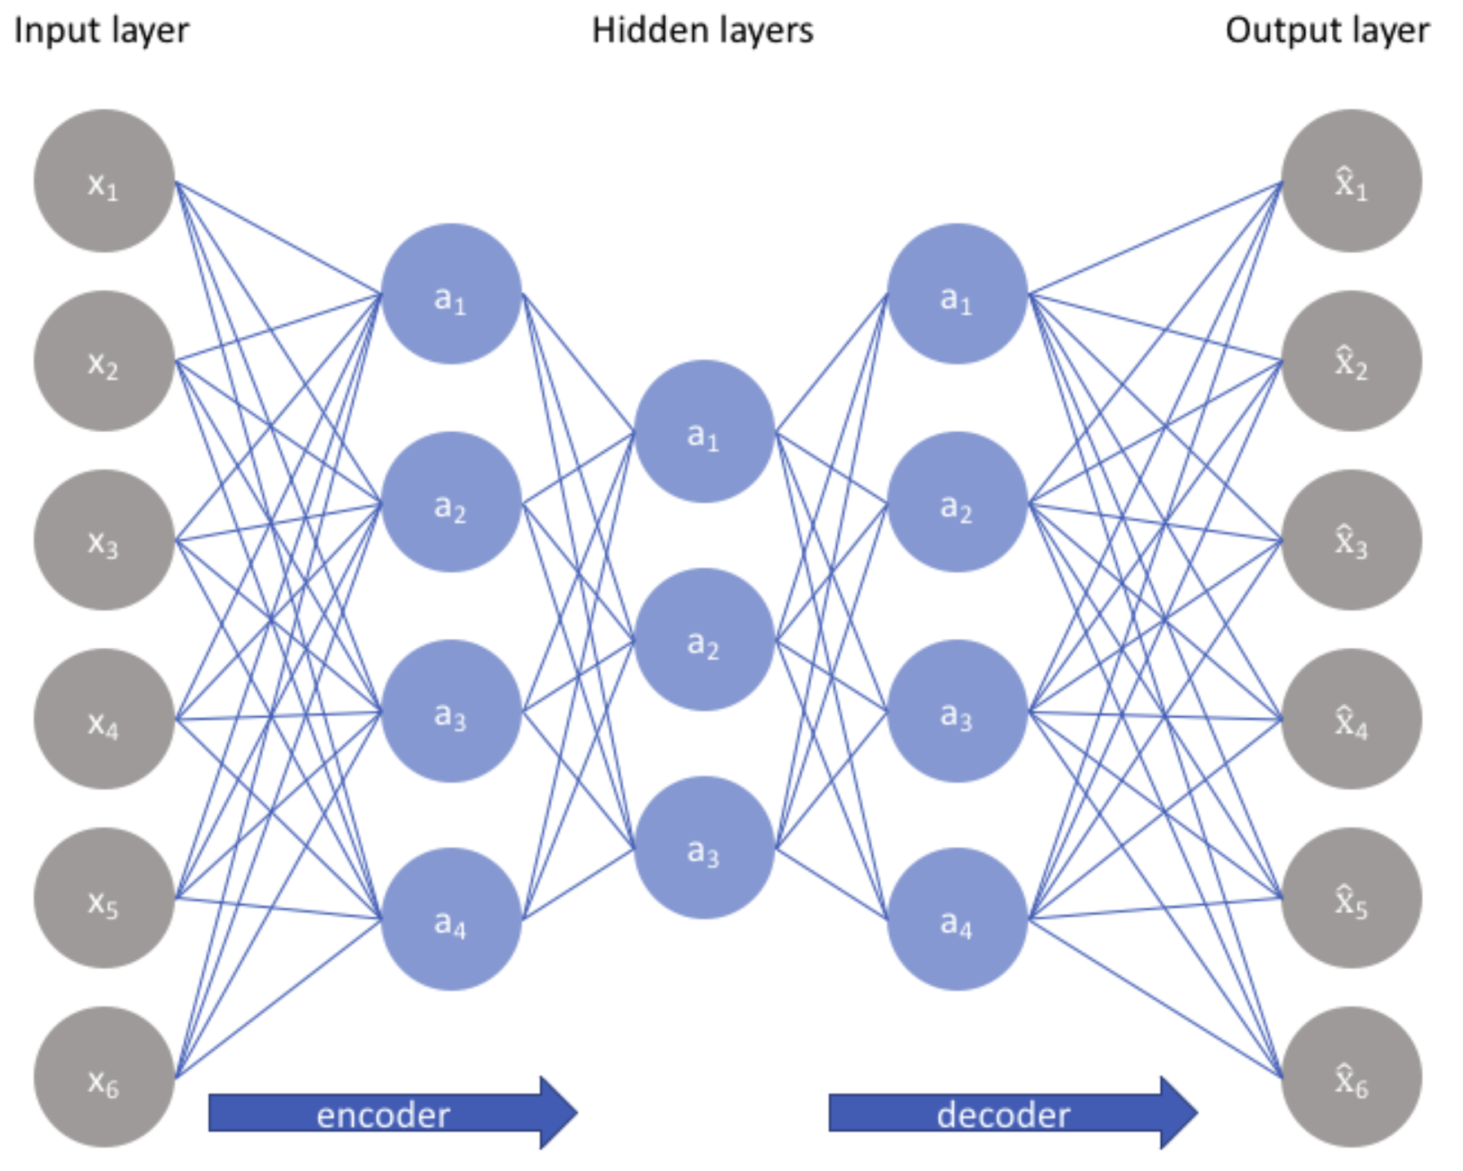
Undercomplete autoencoder

Slide 27
Undercomplete autoencoder
The simplest architecture for constructing an autoencoder is to constrain the number of nodes present in the hidden layer(s) of the network
It limits the amount of information that can flow through the network
By penalizing the network according to the reconstruction error, our model can learn the most important attributes of the input data and how to best reconstruct the original input from an "encoded" state
Ideally, this encoding will learn and describe latent attributes of the input data
It can remove noise from the data

Slide 28
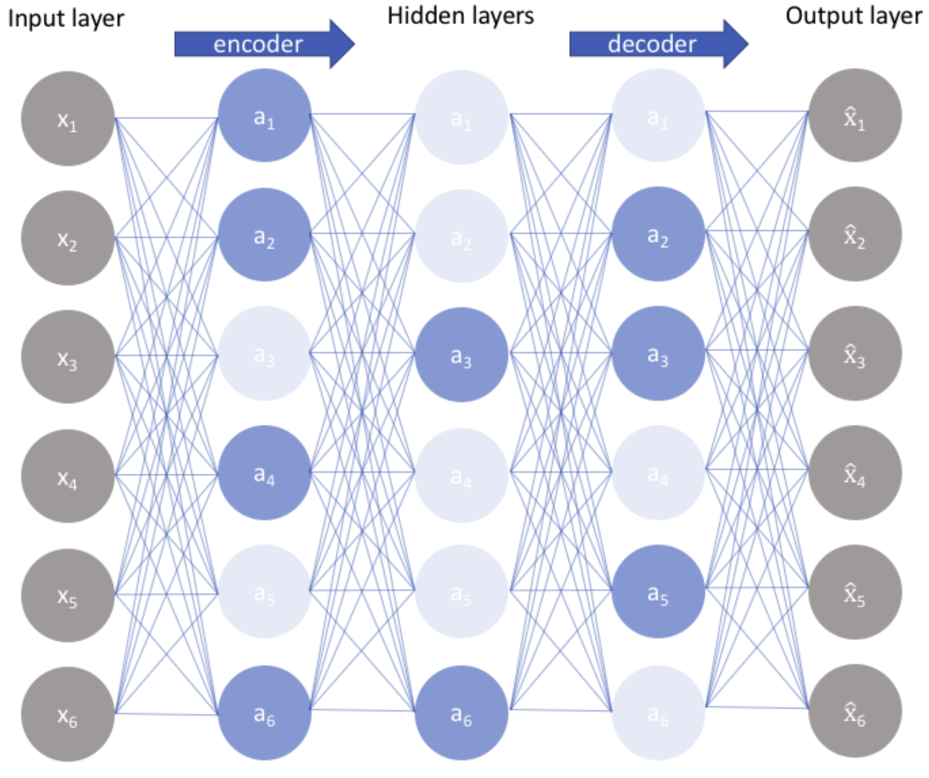
Sparse autoencoders

Slide 29
Sparse autoencoders
Sparse autoencoders keep the number of nodes in hidden layers same as the input
Rather, loss functions are constructed to penalize activations within a layer
Individual nodes of a trained model which activate are data-dependent
Different inputs will result in activations of different nodes through the network
An undercomplete autoencoder will use the entire network for every observation, a sparse autoencoder will be forced to selectively activate regions of the network depending on the input data
Therefore, sparse autoencoders limits the network's capacity to memorize the input data without limiting the networks capability to extract features from the data

Slide 30
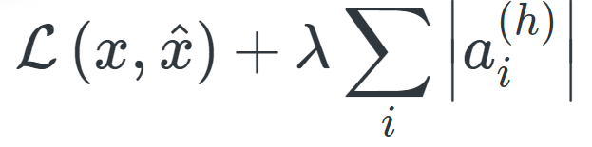
How to keep neurons deactivated?
L1 Regularization
We can add a term to our loss function that penalizes the absolute value of the vector of activations
In layer h for observation i, scaled by a tuning parameter λ

Slide 31
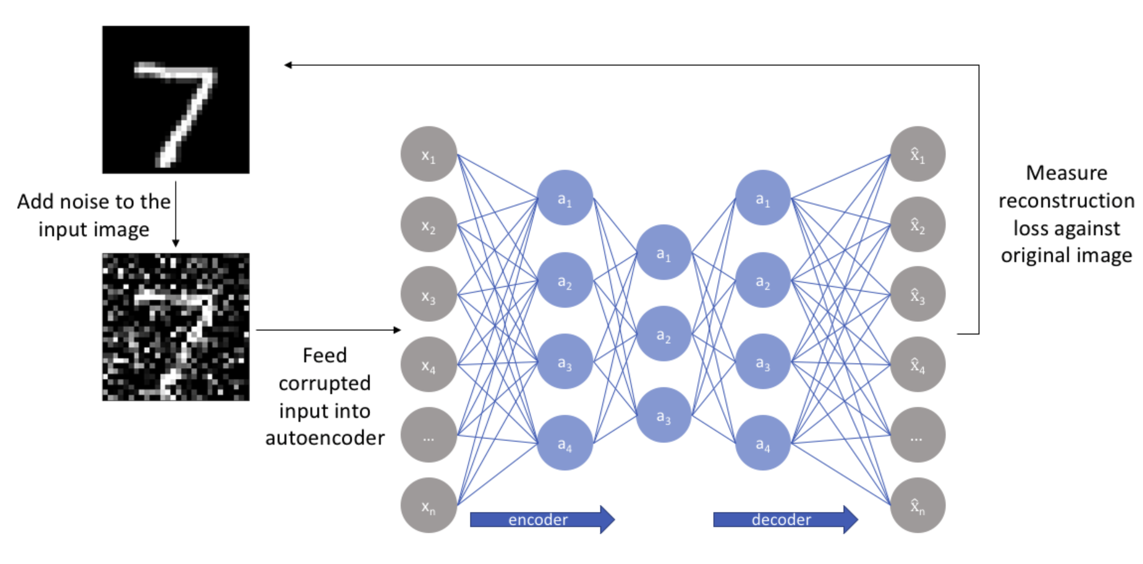
Denoising autoencoders

Slide 32
Denoising autoencoders
With this approach, our model isn't able to simply develop a mapping which memorizes the training data because our input and target output are no longer the same
Rather, the model learns a vector field for mapping the input data towards a lower-dimensional manifold

Slide 33
Autoencoders: In summary
Our input data is converted into an encoding vector where each dimension represents some learned attribute about the data
The encoder network is outputting a single value for each encoding dimension
The decoder network takes these values and attempts to recreate the original input

Slide 34
Modeling Sequences
When applying machine learning to sequences, we often want to turn an input sequence into an output sequence that lives in a different domain
Turn a sequence of sound pressures into a sequence of word identities
When there is no separate target sequence, we can get a training signal by trying to predict the next term in the input sequence
The target output sequence is the input sequence with an advance of 1 step
This seems much more natural than trying to predict one pixel in an image from the other pixels or one patch of an image from the rest of the image
For temporal sequences, there is a natural order for the predictions
Predicting the next term in a sequence blurs the distinction between supervised and unsupervised learning
It uses methods designed for supervised learning, but it doesn't require a separate teaching signal

Slide 35
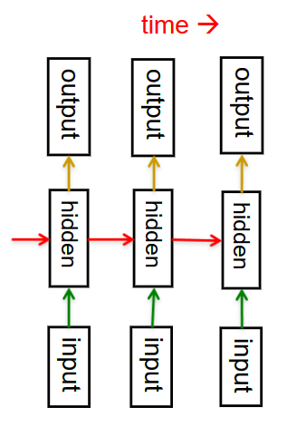
Recurrent neural networks
RNNs are very powerful because they combine two properties:
Distributed hidden state that allows them to store a lot of information about the past efficiently.
Non-linear dynamics that allow them to update their hidden state in complicated ways.
With enough neurons and time, RNNs can compute anything that can be computed by any computer.

Slide 36
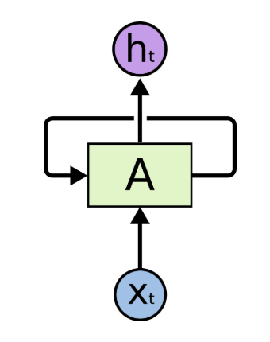
One RNN Unit
And RNN
Update the hidden state in a deterministic nonlinear way
Then use the next symbol from the sequence as input to the same unit

Slide 37
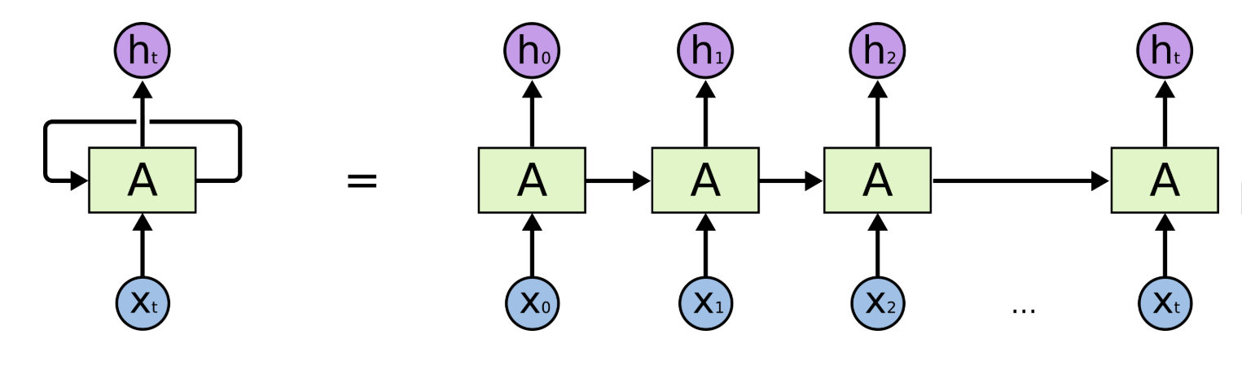
How does it look?

Slide 38
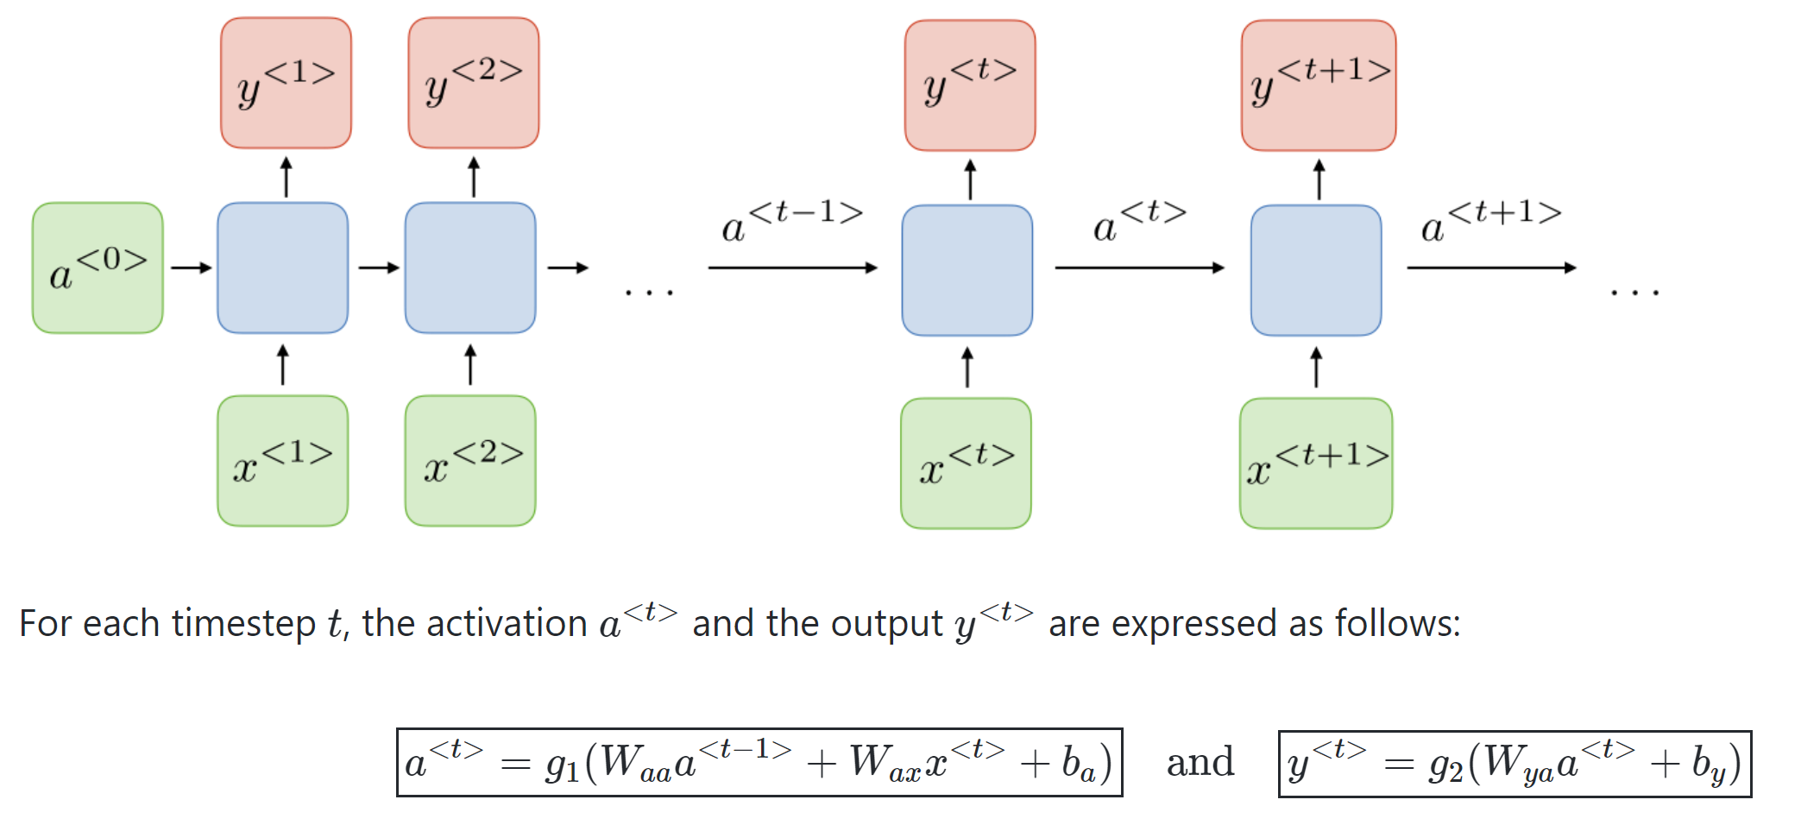
With a little more details

Slide 39
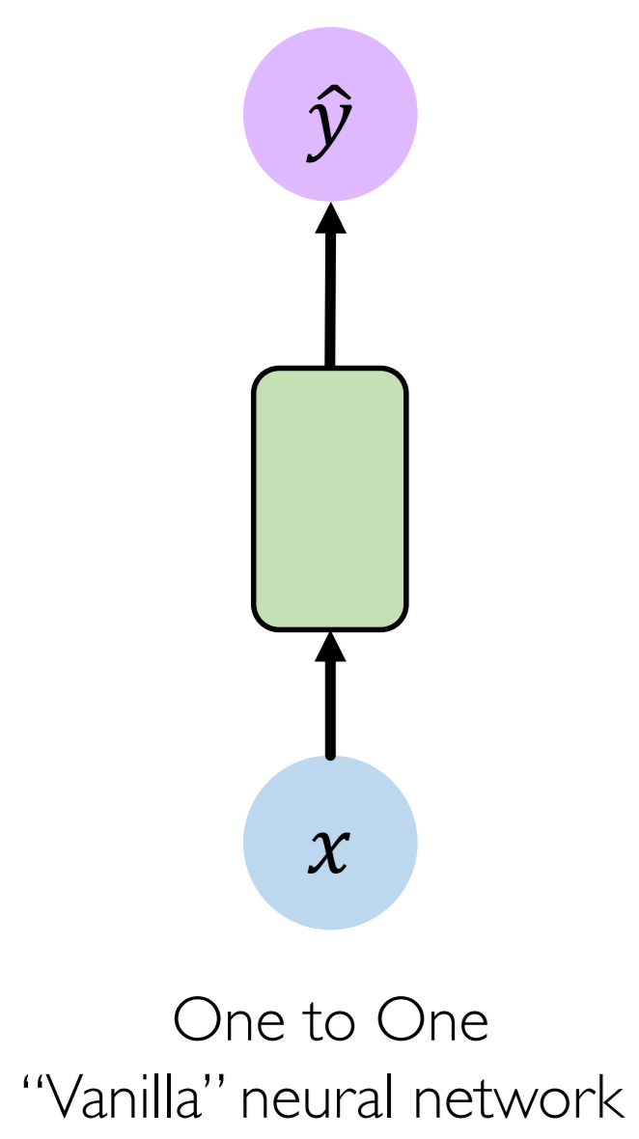
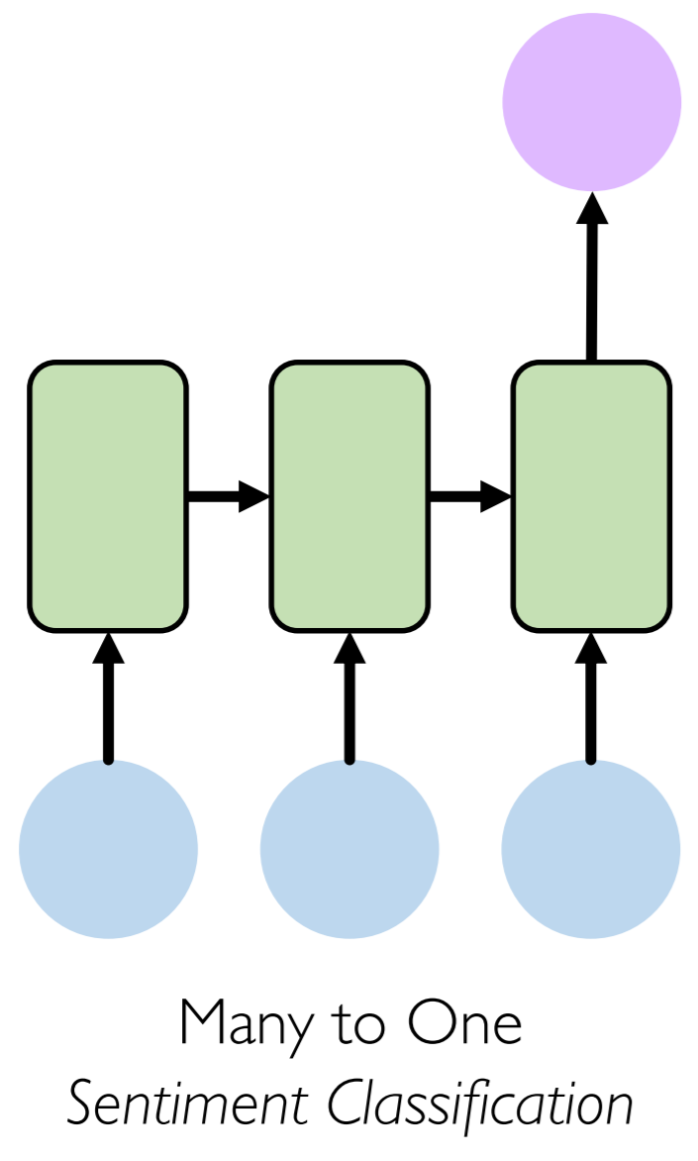
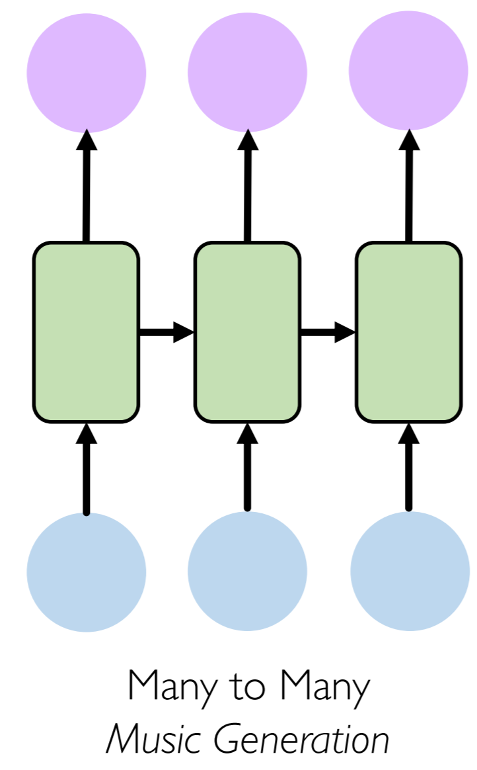
Types of RNN

Slide 40
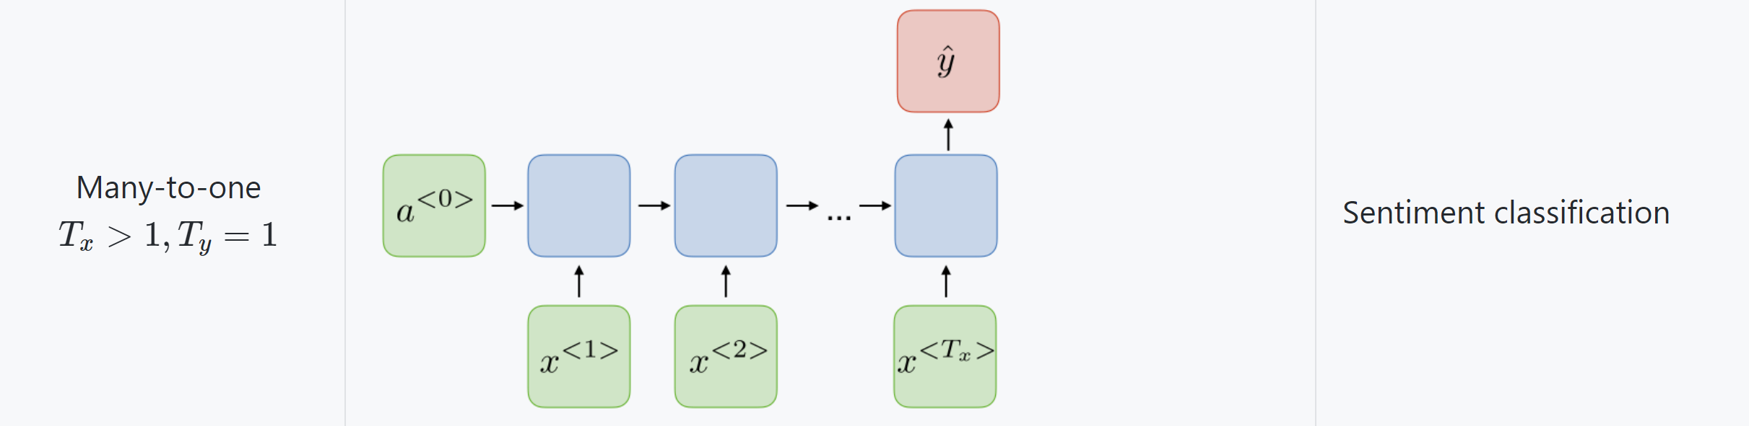
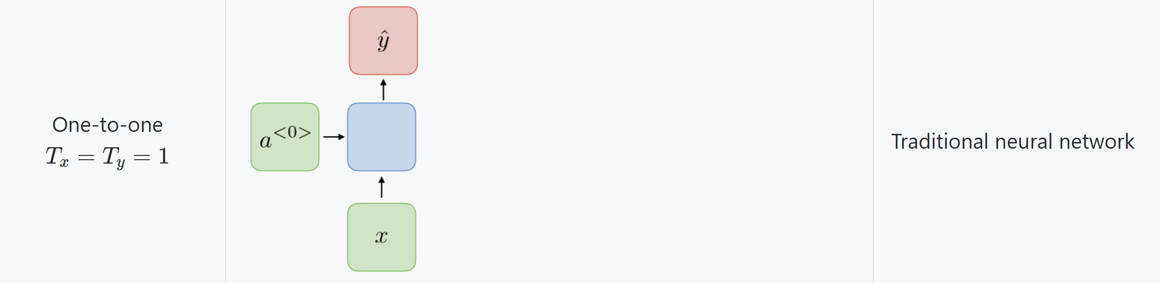
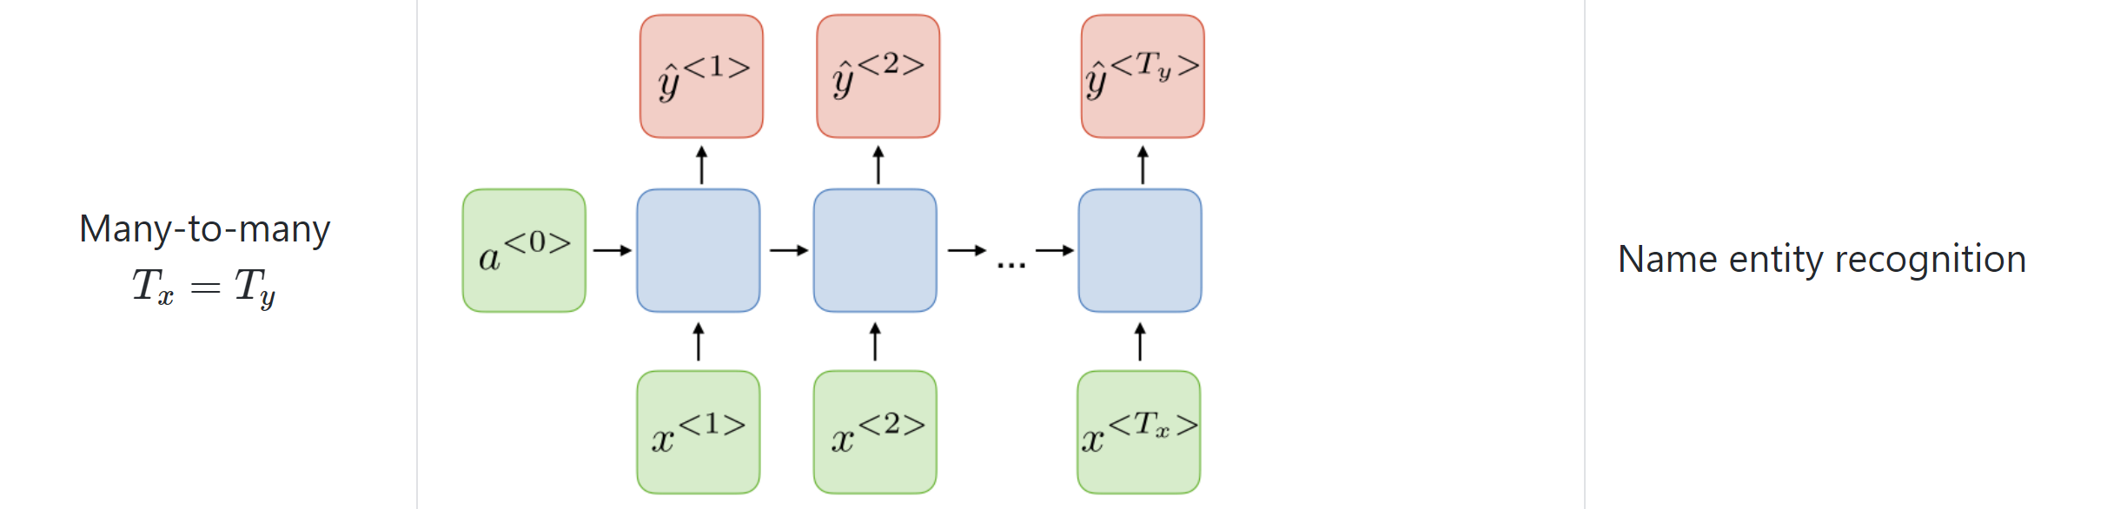
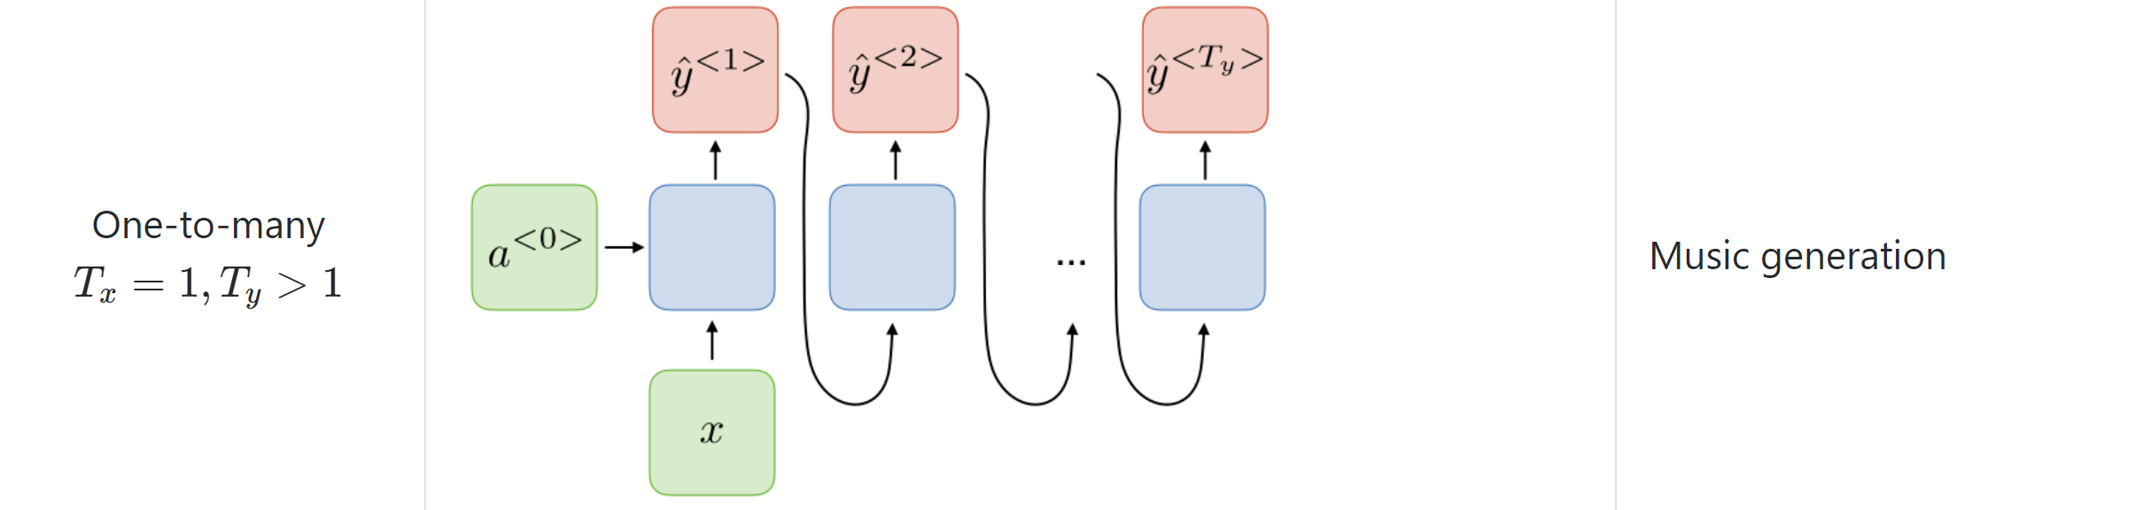
RNN Architecture for different applications

Slide 41
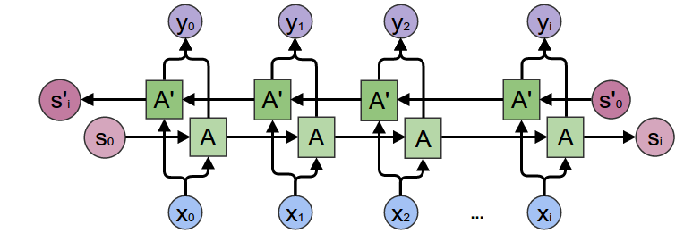
Bidirectional RNN
Bidirectional recurrent neural networks(RNN) combine two independent RNNs
Input sequence is fed in normal time order
The outputs of the two networks are usually concatenated at each time step

Slide 42
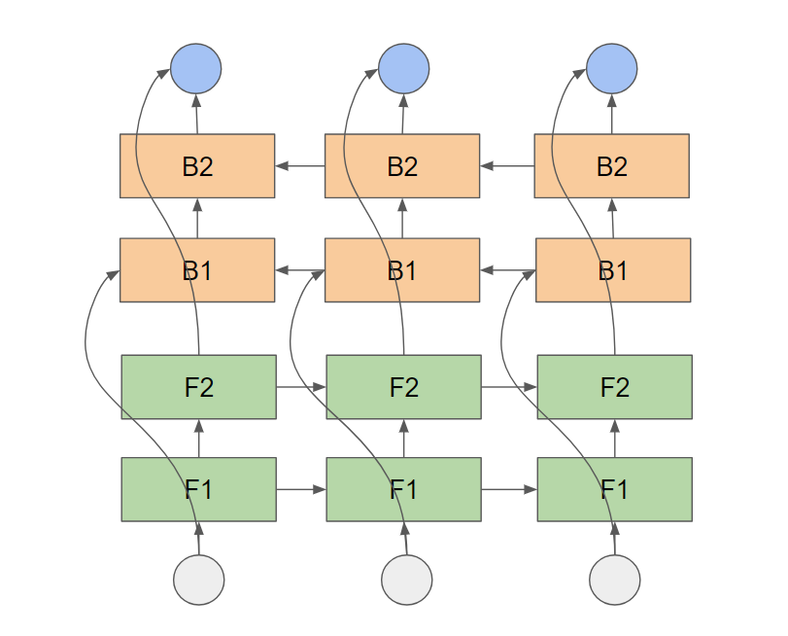
Stacked RNN

Slide 43
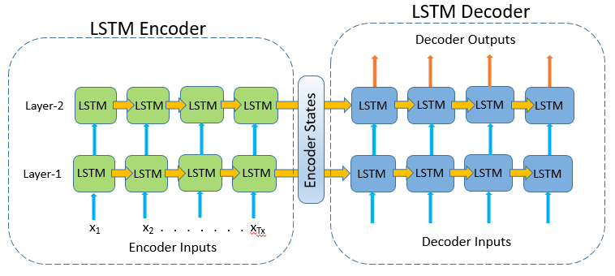
Encoder-Decoder RNN

Slide 44
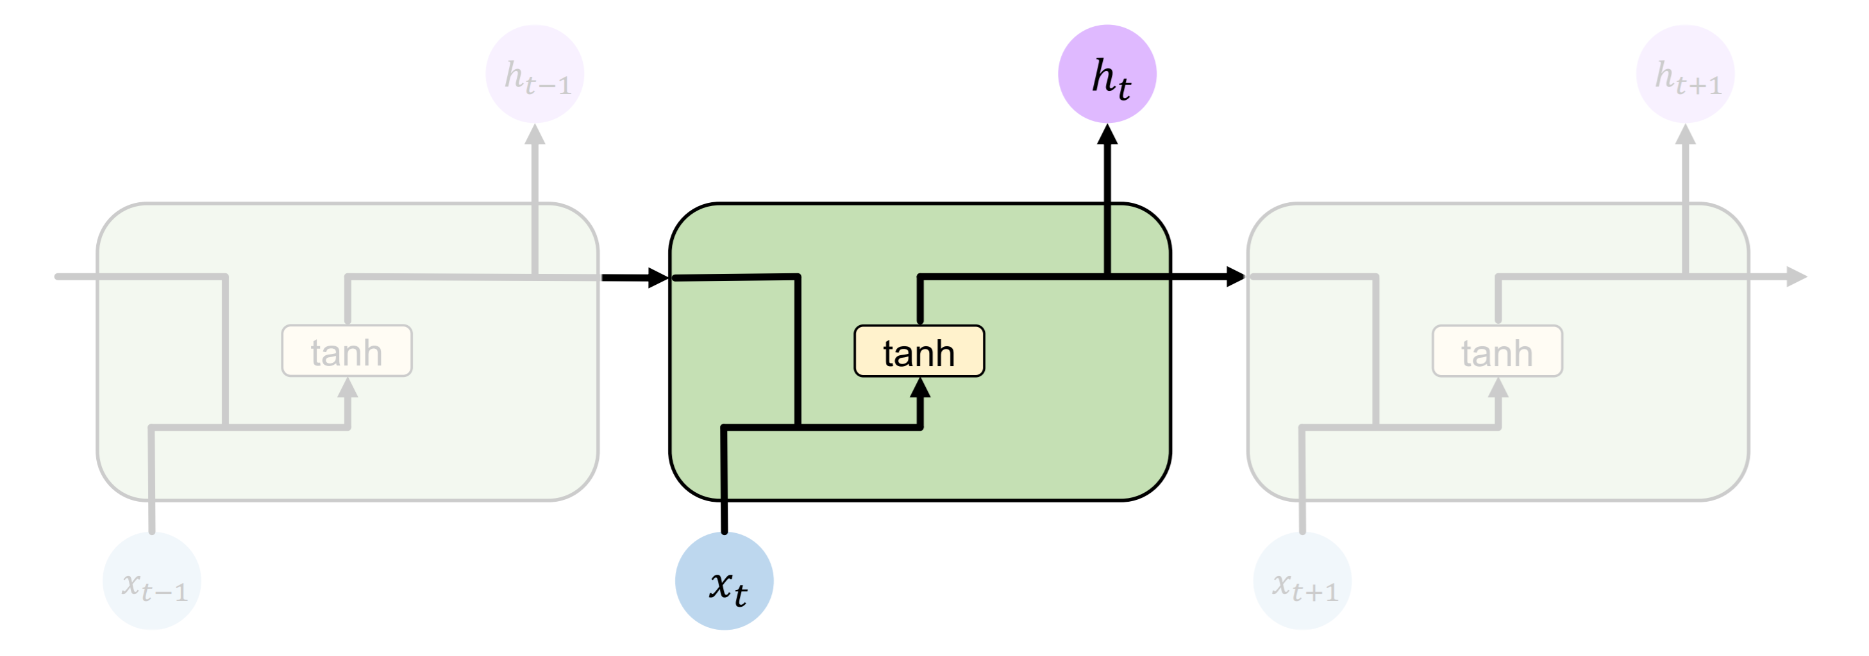
Standard RNN
In standard RNN repeating modules contain a simple computation unit

Slide 45
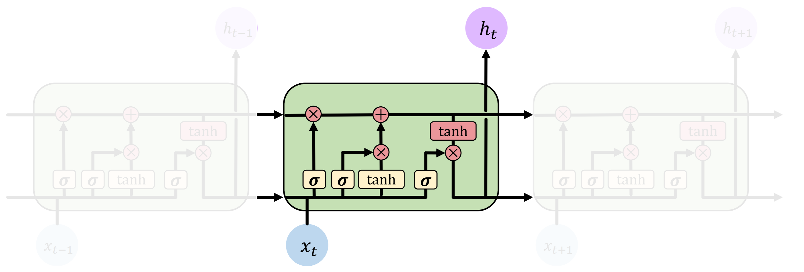
LSTM
LSTM repeating modules contain interacting layers that control information flow
LSTM cells can track information throughout many timesteps

